Slide 2
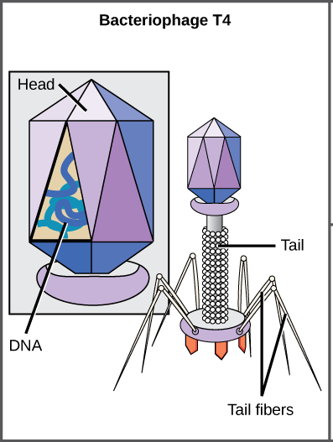
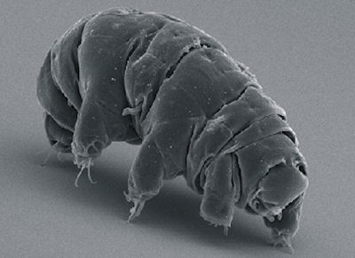

Slide 3
Encountering God

Slide 4
Isaiah 6:1-5

Slide 5
Ezekiel 1

Slide 6
Matthew 17:1-9

Slide 7
The Reviewer has a higher responsibility

Slide 8
Do I see Him high and
lifted up?

Slide 9
Do I see reality around me?

